Slide 1

Events Management: Principles & Practice, 4th Edition
By Razaq Raj and Tahir Rashid

Slide 2
Chapter 3
Event Entrepreneurship
To provide an overview of entrepreneurship in the events industry
Theories of entrepreneurship will be discussed
The events industry mainly includes the designing, promoting, advertising and delivery of an event, but also includes a range of supporting professions and boundary industries.
The events industry in the West is still thriving, with plenty of opportunities for innovative and intuitive event entrepreneurs.

Slide 3
What is entrepreneurship?
An entrepreneur is a person who identifies an opportunity or a new idea and develops it into a new venture project. (Burke 2008)
An event entrepreneur will manage the entrepreneurship process involving planning, organising, promoting, directing, controlling, managing and delivering an event

Slide 4
Entrepreneurship Today
With the internet boom, entrepreneurs have become one of the most dynamic forces in the economy
Entrepreneurs are an economic phenomenon
Challenge for all entrepreneurs is how to start and finance their own business

Slide 5
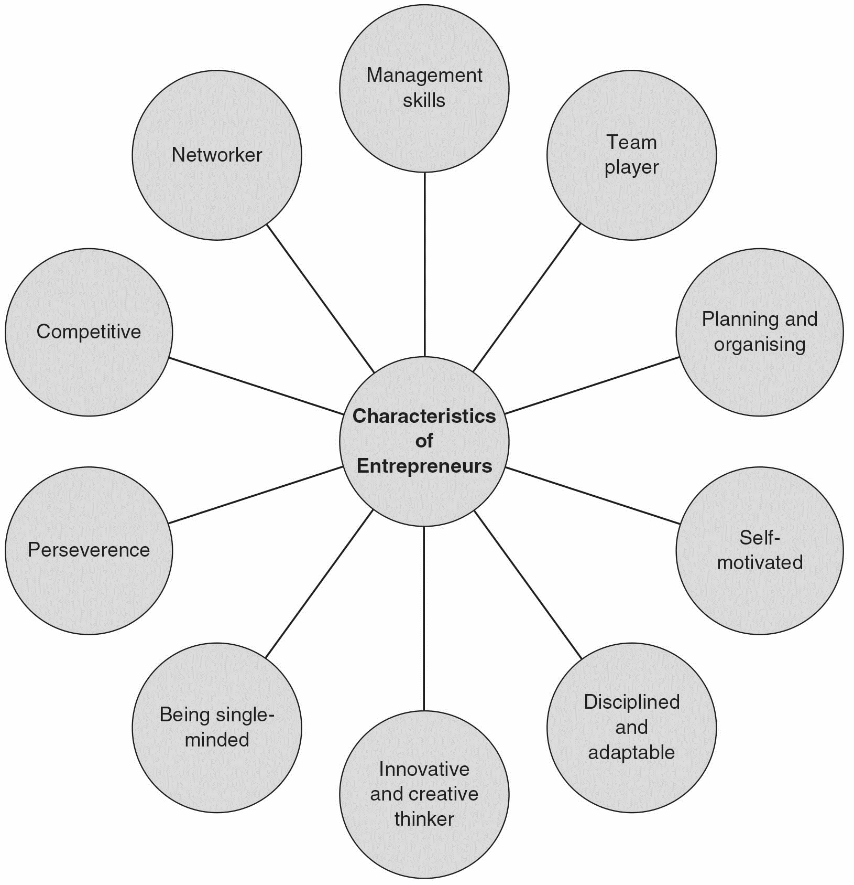
Characteristics of Entrepreneur

Slide 6
Characteristics of entrepreneurs
Ability to take action
Possesses management skills
Team player
Good at planning and organising
Self-motivated and able to motivate others
Disciplined and adaptable
An innovative and creative thinker

Slide 7
Characteristics of entrepreneurs
Single-minded
The ability to work under pressure and persevere
Very competitive
Networker
Has the ability to market
Risk taker

Slide 8
Types of entrepreneurs
Young entrepreneurs
Women Entrepreneurs
Minority Entrepreneurs
Family-owned Business
Copreneurs
Corporate entrepreneur

Slide 9
The entrepreneurial process
The entrepreneur
Resources
Organisation
Market Opportunity

Slide 10
Starting a new event business
“What kind of event business can I start easily and will it be successful?”
Is there a market for your new event idea?
Who are your customers and where are they?
Evaluate thoroughly your talents, skills, experiences and contacts

Slide 11
Advantages of buying an existing business
Risks associated are lower
Lower asset costs
Seller may finance
Buyer has clearer idea of the operations
Established markets
There is a history of the business
Established suppliers
Established customer base
Provide management training

Slide 12
Disadvantages of buying an existing business
Market is saturated and there intense competition
Hidden costs associated with the business
Seller is dishonest and may back out
Inadequate market potential
The business is not worth much

Slide 13
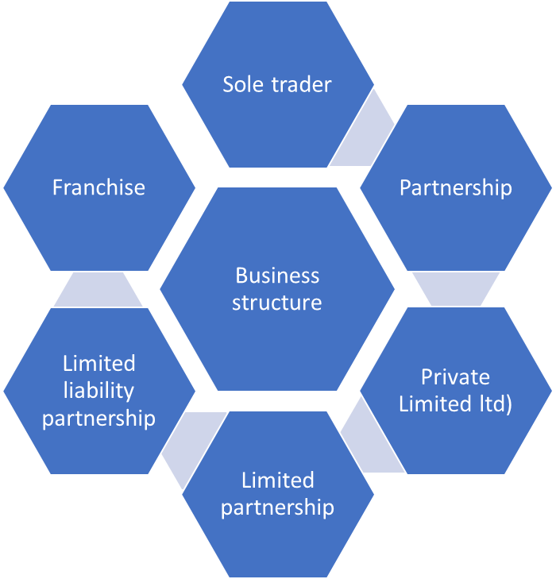
Business structure options available to an entrepreneur

Slide 14
Summary
Event entrepreneur is the key innovative person managing the entrepreneurial process
Today entrepreneurs have become one of the most dynamic forces in the economy
Entrepreneurs are action oriented and risk takers
Start a new event business or buy an existing one?

Slide 15
Further Reading
Barringer, R.B. and Ireland, D. (2015) Entrepreneurship. London: Pearson.
He, F.V., Siren, C., Singh, S. Solomon, G., Krogh, V. G. (2018) Keep Calm and Carry On: Emotions Regulations in Entrepreneurs’ Learning from Failure, Entrepreneurship Theory and Practice, 42 (4) 605-630
Kobia, M. and Sikalieh, D. (2010) ‘Towards a search for the meaning of entrepreneurship’, Journal of European Industrial Training, 34(2): 110–27.
Rashid, T. (2006) ‘Relationship marketing and entrepreneurship: South Asian business in the UK’, International Journal of Entrepreneurship and Small Business, 3(3/4): 417–26.
Wickham, P. (2006) Strategic Entrepreneurship. Harlow: Financial Times/Prentice Hall.

